Slide 1

Pemograman Visual Working with Files
Muh Ikhwani Saputra

Slide 2
Pemograman Visual
Working with Files

Slide 3
Working with Files
Tujuan Pembelajaran
Mahasiswa mampu mengidentifikasikan Files
Mahasiswa mampu mengidentifikasikan File Dates and Times
Mahasiswa mampu mengidentifikasikan Direktori
Mahasiswa mampu mengidentifikasikan Namespace

Slide 4
Files The Easy Way
Copy
Move
Delete
Exists

Slide 5
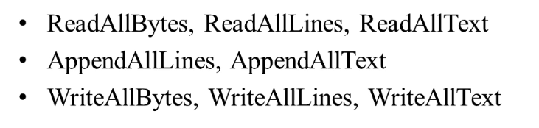
System.IO.File

Slide 6
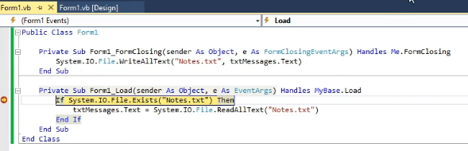
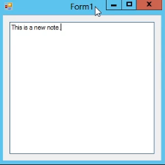
Files

Slide 7
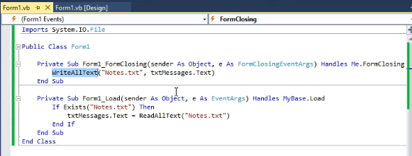
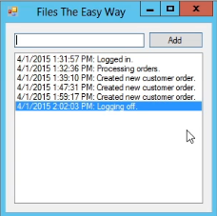
Files

Slide 8
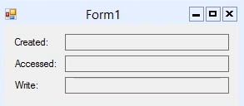
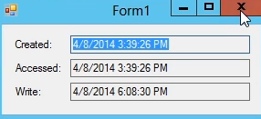
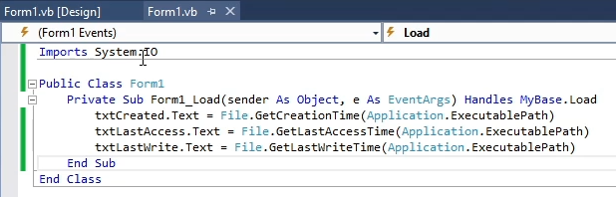
Files Dates and Times

Slide 9
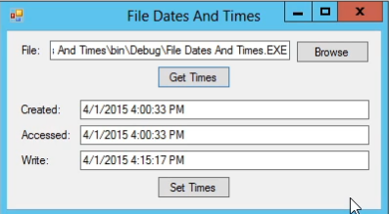
Files Dates and Times
Build This Program !

Slide 10
Working with Directories
Move
Delete
Exists
CreateDirectory

Slide 11
Working with Directories
System.IO.Directory
EnumerateDirectories
EnumerateFiles
GetFiles

Slide 12
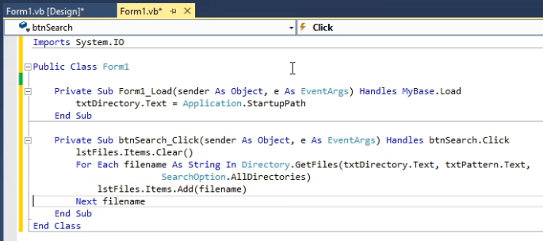
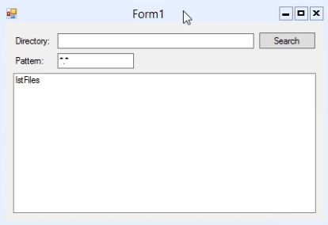
Working with Directories

Slide 13
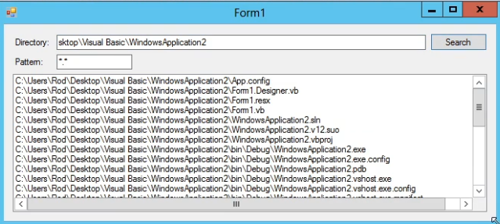
Working with Directories

Slide 14
The My Namespace
My.Application
My.Settings
My.User
My.Computer

Slide 15
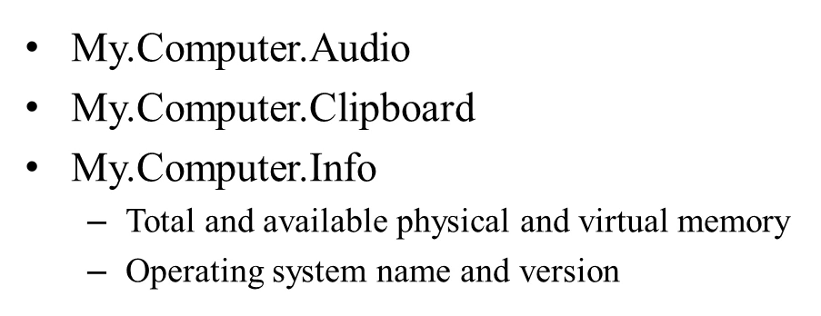
My.Computer

Slide 16
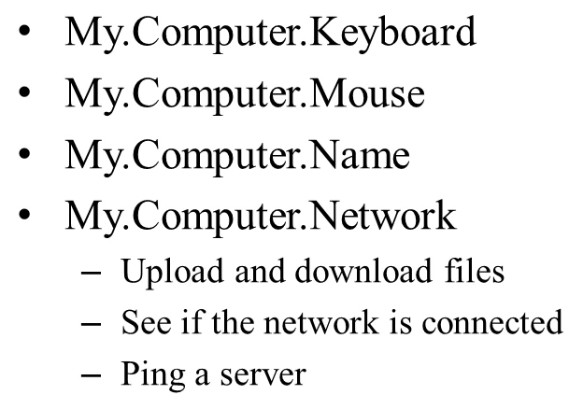
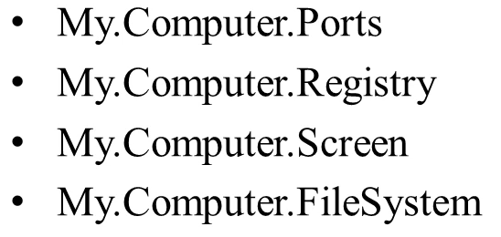
My.Computer

Slide 17
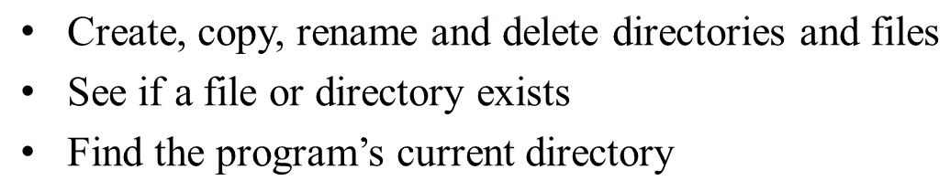
My.Computer.FileSystem

Slide 18
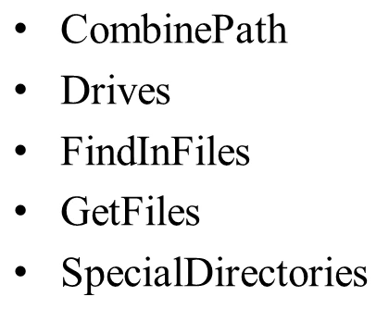
My.Computer.FileSystem

Slide 19
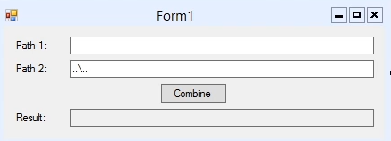
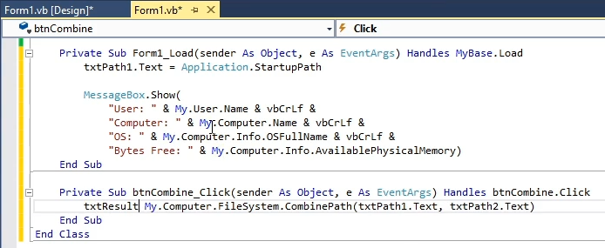
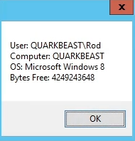
Working with Directories

Slide 20
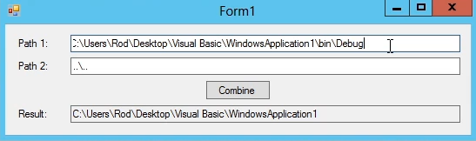
Working with Directories

Slide 21
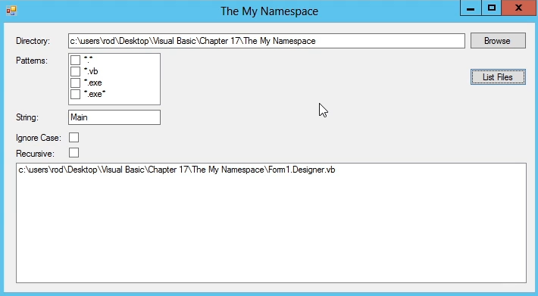
Challenge
Buatlah program seperti dibawah ini :

Slide 22
Pemograman Visual
Working with Files

